Slide 1
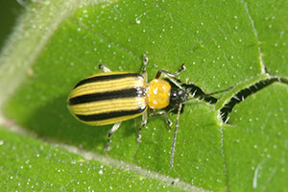
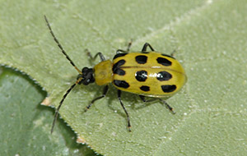
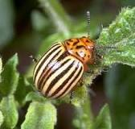
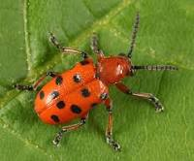
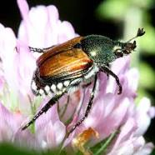
Top 10 invasive insects? Insect family and life history are good predictors of invasive status
Two on right: Corn rootworms
Stripped center: Colorado potato beetle
Left: Asparagus beetle
All Family Chrysomelidae,
Locally abundant, not FQ status, WHY?
FQ, Japanese beetle Family Scarabaeidae
Dr. Vera Krischik, Assoc Professor/Extension Spec,
Depart Entomology, UMinnesota, krisc001@umn.edu
https://ncipmhort.cfans.umn.edu
https://pesticidecert.cfans.umn.edu

Slide 2
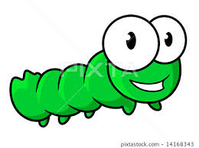
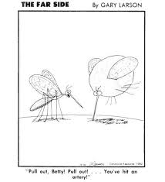
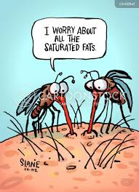
Insect humor: getting your attention

Slide 3
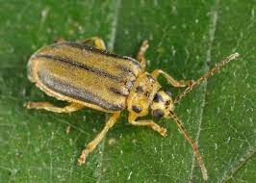
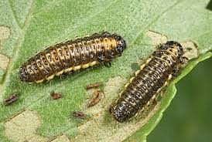
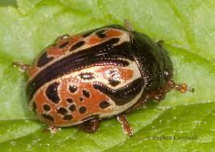
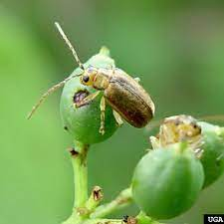
Invasive, native, exotic, risk??
Native, occurs naturally, has predators and pathogens: Elm leaf beetle, introduced, American elm, controlled by Harmonia, Asian lady beetle
Invasive, high population growth, can be native or exotic; native ninebark beetle, not a lot of ninebark shrubs, locally invasive
Exotic introduced w/o predators and pathogens, high risk, high population size, lots of viburnum shrubs

Slide 4
Outline: Top 10 invasive insects
WHAT MAKES SOME SPECIES BETTER AT BEING INVASIVE?
FAST GROWTH RATE,
FREE FROM PREDATOS AND DISEASSE,
ABUNDANT HOST,
GOOD DISPERSAL
Insect pests can be grouped according to the way they damage the plant.
Insects that vector diseases are the most damaging and insects that remove leaf tissue are the least.
Insect evolution is conservative so if you know the family of the insect, then most insects in that family will perform similar damage.
We will discuss how to mange invasive pests and the discuss similar species in the landscape that can be managed.

Slide 5
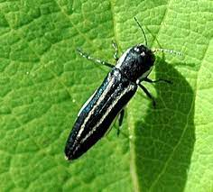
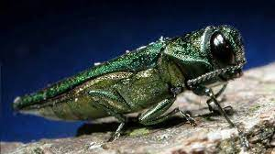
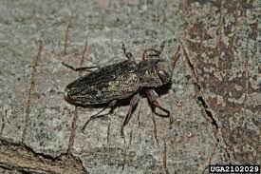
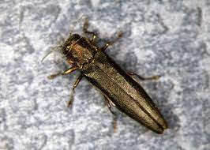
Invasive, Exotic, Native = risk?
beetle family Buprestidae,
flatheaded bores or metallic wood boring
beetles includes:
Twin lined chestnut borer, native,
follows oak wilt, low risk,
Emerald ash borer, exotic, invasive,
high risk
Flatheaded apple tree borer, native,
follows stress, low risk
Bronze birch borer, native,
European birch high risk

Slide 6
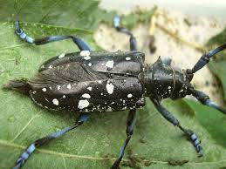
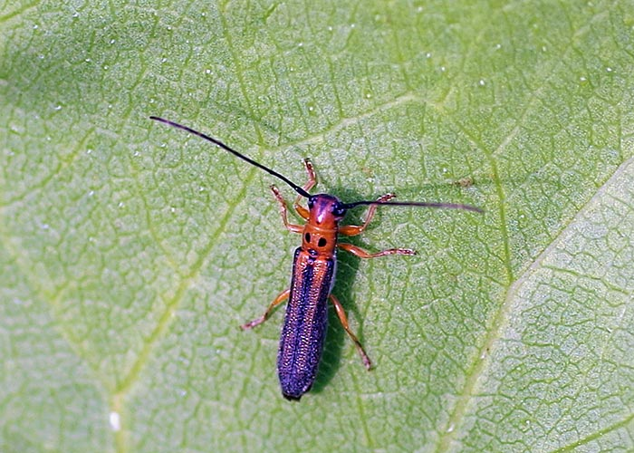
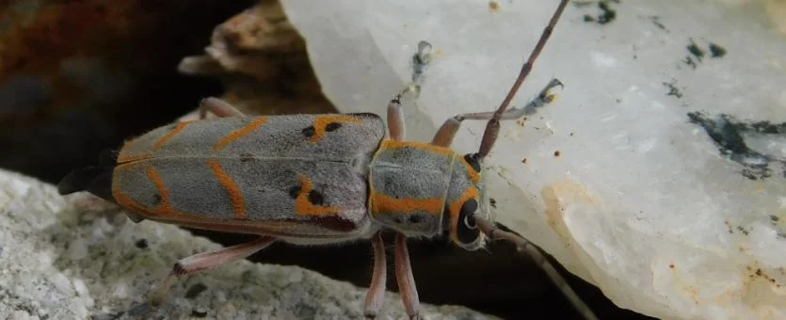
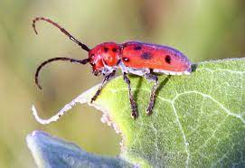
Invasive, Exotic, Native = risk?
beetle family Cerambycidae,
rounheaded bores or longhorned
beetles includes:
Asian longhorned beetle, exotic, invasive,
Maples, high risk
Dogwood twig borer, native, low risk
Elm borer, native,
follows stress, high risk, DED vector
Milkweed beetle, native, low risk

Slide 7
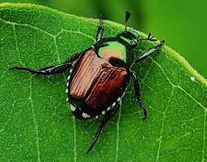
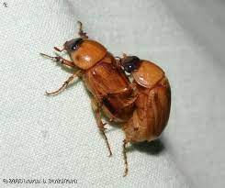
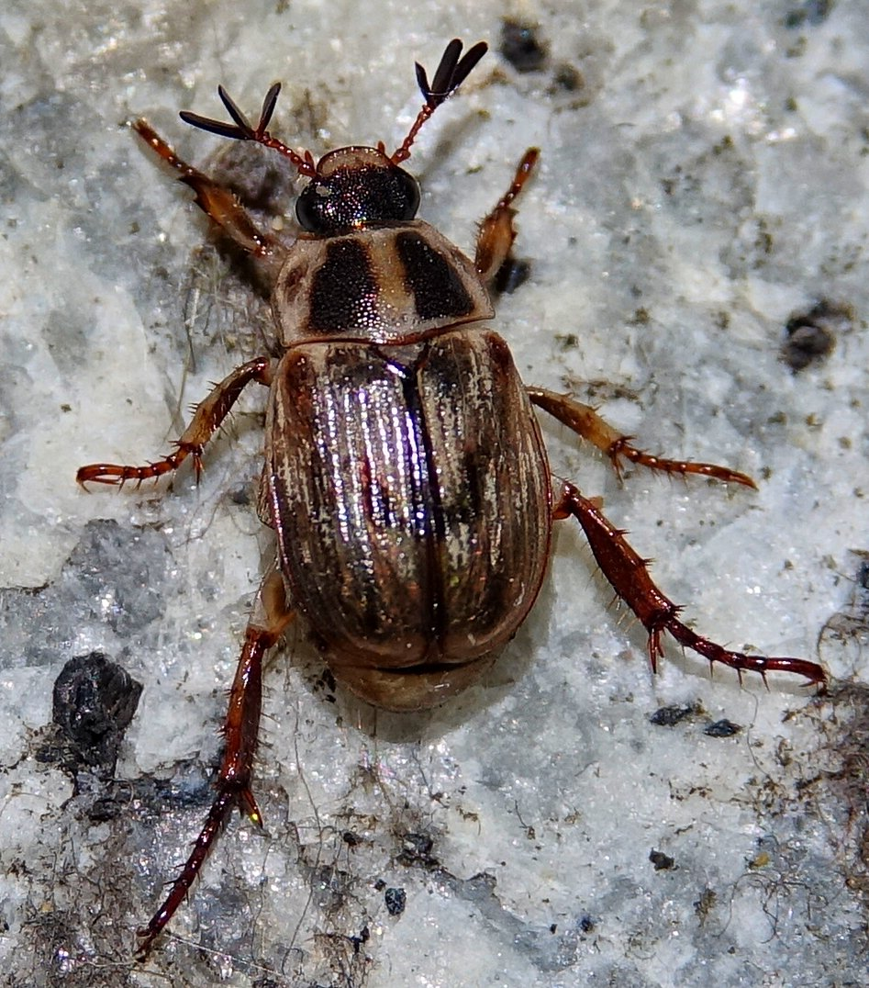
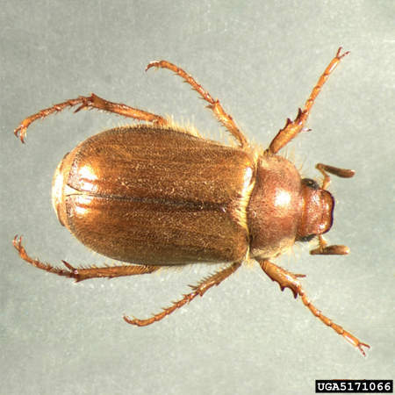
Invasive, Exotic, Native = risk?
beetle family Scarabaeidae,
Scarab beetles includes:
Japanese beetle, exotic, invasive,
Roses. Linden, turf, high risk
Masked chafer, native, low risk
Oriental beetle, high risk,
European chafer, exotic, new MN
Low risk

Slide 8
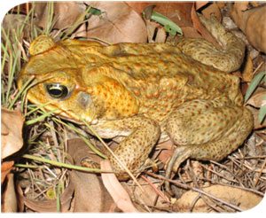
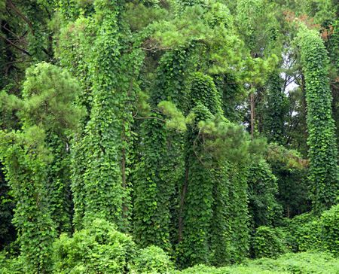
Outline: Top 10 invasive species in world
Kade toad, 1935, from Central/South America, introduced into Australia for biocontrol of greyback cane beetle.
Kudzo, vine, fast growing, from Asia in 1876, introduced to control soil erosion and increase soil fertility as it is a legume and fixes nitrogen in US
beetle
Burmese Python
Black rat
Snakehead Fish
Asian Carp
Cotton whitefly
Asian Tiger Mosquito
Killer bees

Slide 9
Outline: Top 10 invasive insect species
Afrancanized “killer” bees
Burmese Python
Black rat
Snakehead Fish
Asian Carp
Cotton whitefly
Asian Tiger Mosquito
Zebra mussels

Slide 10
Outline of talk: Top 10 insect pests
The top 10 invasive insects in landscapes
What is the difference between IPM and organic control
Most insecticides kill bees, why are neonicotinoids receiving so much scrutiny?
JB control w/o neonicotinoids

Slide 11
Binomial nomenclature, 1758
Carl Linnaeus, born 1707,Sweden
Systema Naturae, from 1737-1758
Order: Lepidoptera
Family: Lymantriidae, tussock moth
Genus, species
Lymantria dispar
Common name: gypsy moth

Slide 12
Top 10 landscape insect pests
1. FQ IE. emerald ash borer: ash
2. FQ IE. Gypsy moth; many plants
3. FQ IE. hemlock wooly adelgid; hemlocks in Great Smoky MT
4. FQ IE. European elm beetle, killed most American Elms
5. Native. Erwinia amylovora vectored by bees, killed American ash
6. IE, birch leaf miner sawfly; birch
7. FQ IE. Asian long-horned beetle; maples
8. FQ IE. Japanese beetle; lindens, roses
9. FQ IE. spotted wing drosophila; all berries
10. Q IE. spotted lanternfly; many plants
11. FQ IE. brown marmorated stink bug; fruits, veggies
12. FQ IE. Asian giant hornet; kills everything
13. FQ IE.Jumping worms; destroys soil
worst

Slide 13
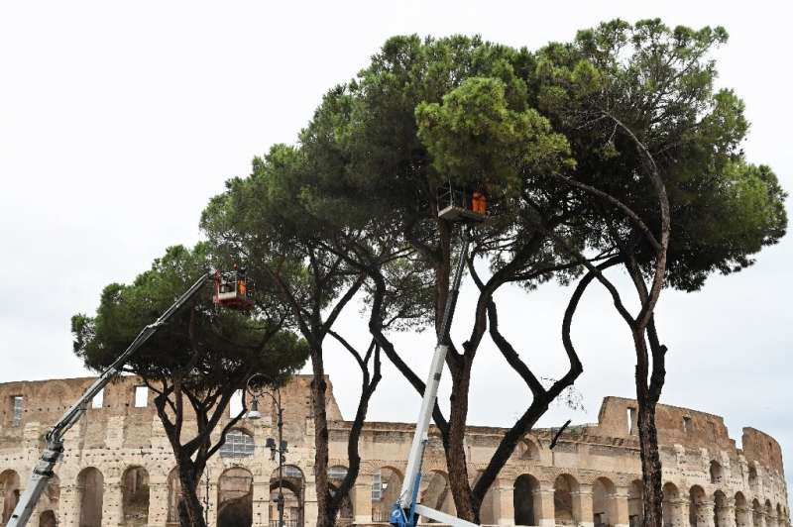
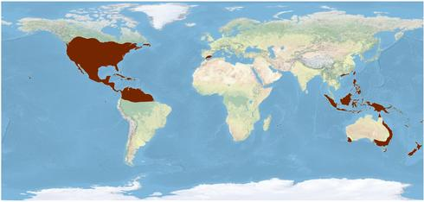
Do we send invasive, exotic around the wolrld from the US? YES
2015 Japanese beetle is a serious pest in mainland Europe; at two airports in northern Italy at Piedmont and Lombardy, feeding on both wild plants and nearby crops.
2020 Pine tortoise scale invades umbrella pines in Rome
1840 Monarch butterflies in Hawaii, Australia, New Zeland, Spain, Pacific Islands, and International Space Station!!

Slide 14
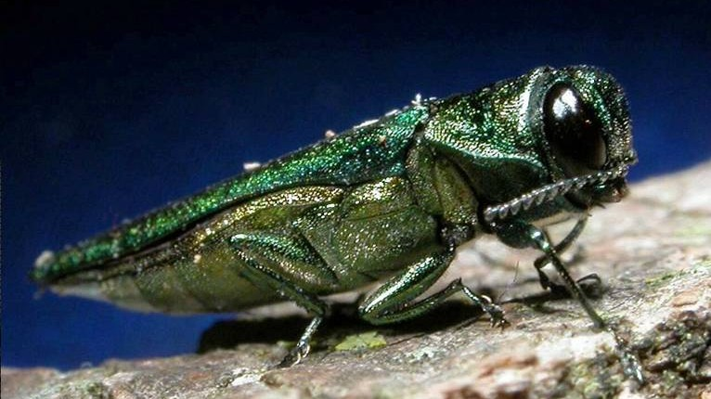
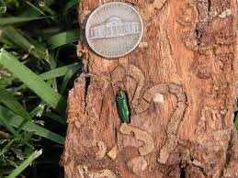
Agrilus planipennis, Emerald ash borer, Asia, 1992, FQ
Arrived 1992 near Detroit, Michigan, and in 2009 in MN
and spread to 30 states and 5 Canadian provinces,
100% fatal in ash, 100 million ash trees killed

Slide 15
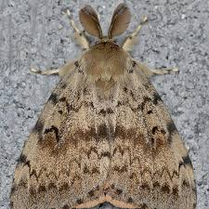
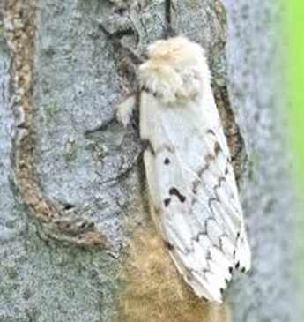
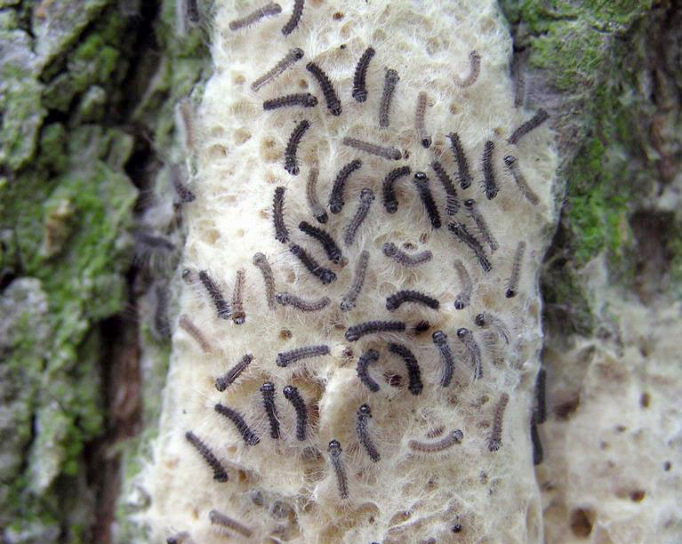
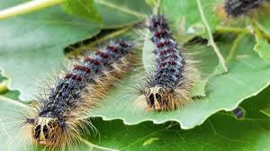
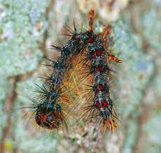
Lymantria dispar, gypsy moth, Asia, 1868 feds gregariously on oaks and other trees; imported to make American silkworm industry; failed

Slide 16
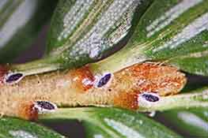
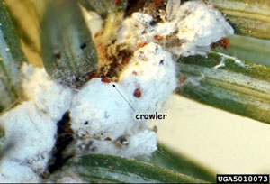
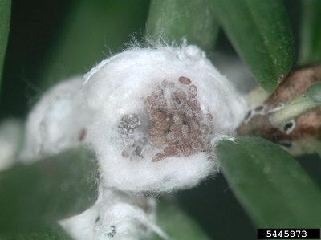
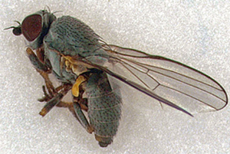
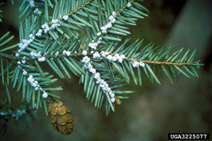
Adelges tsugae, hemlock wooly adelgid, Japan, 1920 feeds on hemlock and kills the tree

Slide 17
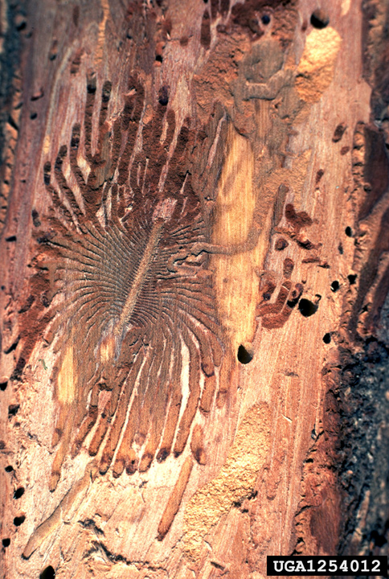
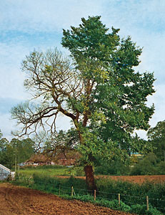
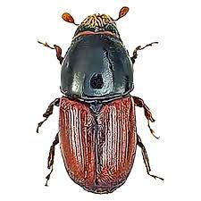
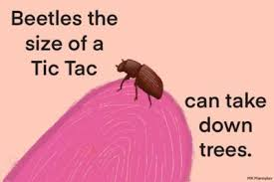
Adelges tsugae, European elm bark beetle vectors DED,Europe, Asia, 1930 feeds on elms

Slide 18
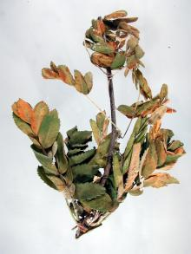
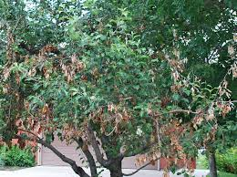
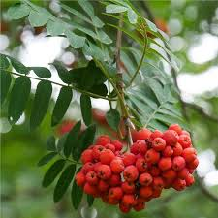
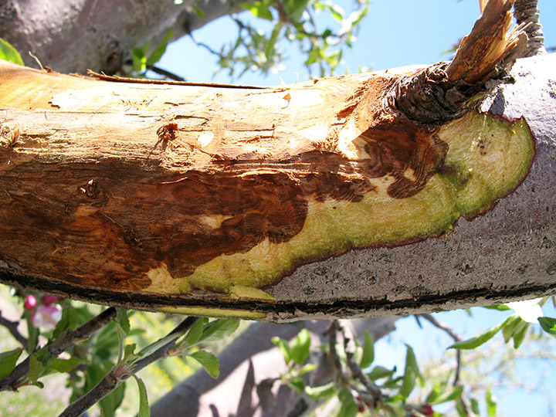
Erwinia amylovora bacteria and bees, Japan, 1920 feeds on hemlock and kills the tree

Slide 19
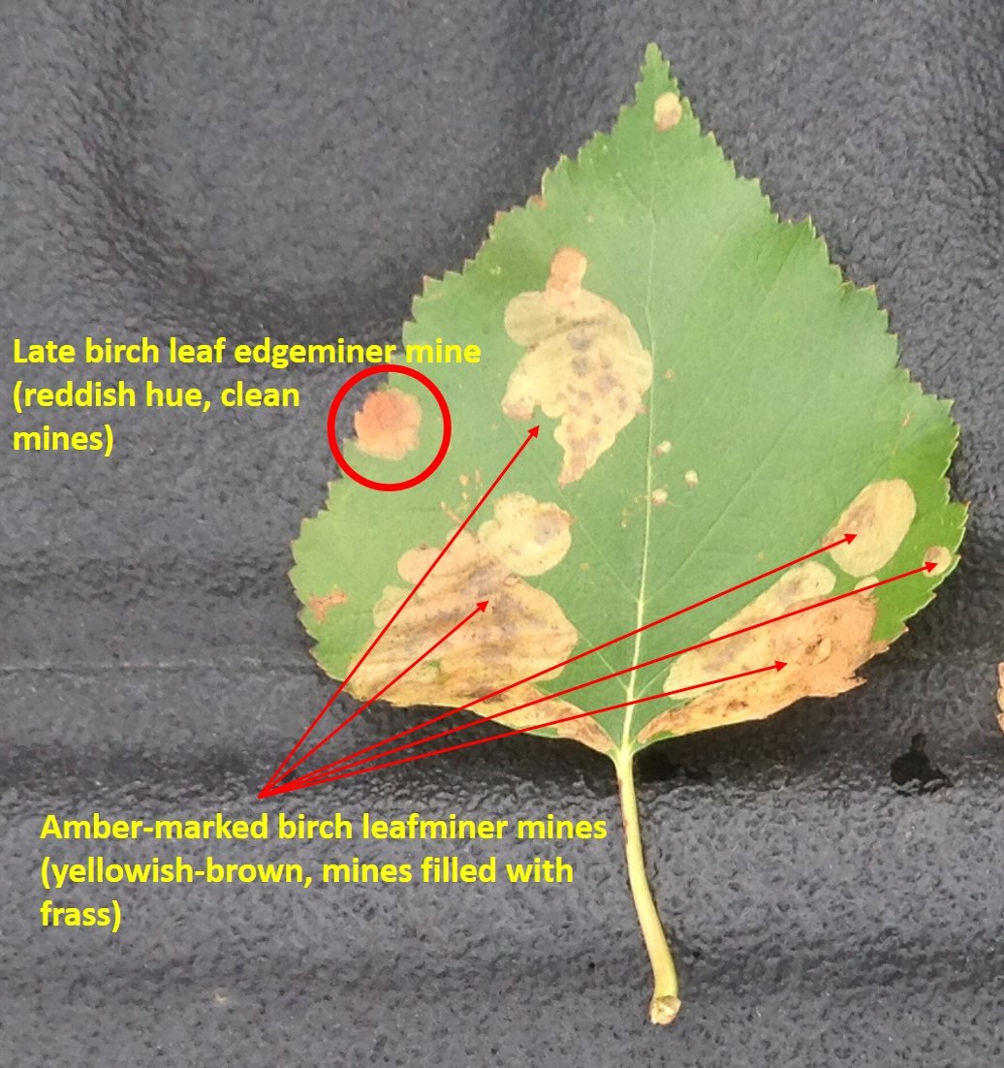
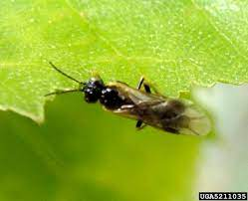
Fenusa pusilla, birch leaf miner sawfly, Europe, 1900 feeds on birch and kills the tree

Slide 20






Anoplophora glabripennis, Asian longhorned beetle, China, Korea, 1996 feeds on maple and kills the tree

Slide 21




Popilla japonica, Japanese beetle, Asia, 1916, spread to 36 state, FQ

Slide 22





Drosophila suzukii, spotted wing drosophila, Asia, 2008 feeds on native and managed berries

Slide 23






Lycorma delicatula, spotted lanternfly, China, India, Vietnam, 2012 feeds tree sap and kills the tree

Slide 24





Halyomorpha halys, brown marmorated stink bug, Asia, 1990 feeds on fruits and veggies

Slide 25

Vespa soror, Asian Hornet, Asia, kills Asian honeybee larvae/brood

Slide 26


Vespera mandarinia, Asian giant hornet, Asia, 2019 in Washington State, FQ

Slide 27




Amynthas agrestis, A. tokioensis and Metaphire hilgendorfi, Jumping worms, Japan, Korea, 1900s, problem since 2000 feeds on organic material and destroys seedlings

Slide 28


Aphids, soybean aphid, invasive, exotic
Adult aphids give birth to live young. Generally, aphids begin giving birth when they are 7 to 10 days old, depending on temperature.
Ohio State University
Green peach aphid adult and young
Ohio State University
Winged green peach aphid adult

Slide 29

Viburnum clearwing borer,
invasive, native
Clearwing borer
Order Lepidoptera
Family Sesiidae
Moth borer larvae feed under bark; adults do not feed
Chlorosis, wilting, and dieback
Many deciduous trees and shrubs

Slide 30

European pine sawfly
Order Hymenoptera
Family Diprionidae
Sawfly larvae feed, adults do not feed
Defoliation
Various pines

Slide 31

Rose slug sawfly
Order Hymenoptera
Family Tenthredinidae
Sawfly larvae feed, adults do not feed
Larvae skeletonize upper leaf surface
Roses

Slide 32

Cottony maple scale
Order Hemiptera
Family Coccidae
Soft scale, sap sucking insect
Yellowing, stunting, dieback
Maple, elm, hawthorn, dogwood, poplar, linden

Slide 33

Pine needle scale
Order Homoptera
Family Diaspididae
Armored scale, sap sucking
Stunting and dieback
Spruce, pine

Slide 34

Kermes scale
Order Hemiptera
Family Kermestidae
Gall-like scale scale, sap sucking
Chlorosis, foliage distortion, and tip dieback.
Oaks

Slide 35

Spruce spider mite
Order Acari
Family Tetranychidae
Sucking, spider relatives
Suck out cells
Conifers

Slide 36

Forest tent caterpillar
Order Lepidoptera
Family Lasiocampidae
Moth larvae feed, adults do not feed
Defoliation
Fruit and shade trees

Slide 37

Whitemarked tussock moth
Order Lepidoptera
Family Lymantriidae
Moth larvae feed, adults do not feed
Defoliation
>60 various host plants

Slide 38

Spring cankerworm
Order Lepidopera
Family Geometridae
Moth larvae feed, adults do not feed
Defoliation, shot hole injury
Apple, elm, oak, hickory, linden, birch, beech, maple

Slide 39

Birch leafminer
Order Hymenoptera
Family Tenthredinidae
Sawfly larvae feed,
adults do not
Hollow out patches between leaf surfaces
Birch trees

Slide 40

Elm leaf beetle
Order Coleoptera
Family Chrysomelidae
Beetle larvae and adults feed
Defoliation
Most elm species

Slide 41

Cooley spruce gall adelgid
Order Hemiptera
Family Adelgidae
Aphid like sucking insect
Galls on tips of branches
Spruce and Douglas-fir

Slide 42

Eriophyid mites
Order Acari
Family Eriophyidae
Sucking arachnids causing erineum, spider relatives
Erineum are gall like, foliage discoloration
Various deciduous and coniferous species

Slide 43

Hackberry nipple gall maker
Order Hemiptera
Family Psyllidae
Adult psyllid, aphid-like
Plant forms gall over insect nymph
Hackberry

Slide 44

Lace bug
Order Hemiptera
Family Tingidae
Lace bug nymphs and adults feed
Stippled, discolored foliage, and dieback
Various trees and shrubs

Slide 45

Honeylocust
plant bug
Order Hemiptera
Family Miridae
Plant bug nymphs and adults feed
Stippled leaf discoloration and distortion
Honeylocust

Slide 46

Cottonwood leaf beetle
Order Coleoptera
Family Chrysomelidae
Beetle larvae and adults feed
Defoliation
Various willow and cottonwood

Slide 47

Black vine weevil
Order Coleoptera
Family Curculionidae
Weevil larvae and adults feed
Root and leaf damage
Yews, many other perennials

Slide 48

White pine weevil
Order Order Coleoptera
Family Curculionidae
Weevil larvae and adults feed
Leader dieback
Pine and spruce

Slide 49


What is IPM?

Slide 50

Japanese beetle was accidently brought to the US prior to 1916, first found in NJ
Currently established in over 25 states

Slide 51


Adult Japanese Beetle: About ½ in. long, emerald green with copper elytra
Main symptom is skeletonized leaves from feeding between veins

Slide 52


Adults are active from mid-June to mid-August and are polyphagous
They feed on >300 plants in about 80 families

Slide 53


Japanese Beetle Damage to Linden Tree
July 8
July 18

Slide 54
Raster

Slide 55

ID white grubs to species by rastral pattern, Why? Damage potential

Slide 56





Life history of scarabs in turf
species | species | years | larval food | adult food
 | JB | one year | turf | adults feed on grape, linden, rose
 | false JB | one year | unknown | adults feed on grape, linden, rose
 | rose chafer | one year | unknown | adults feed on grape, linden, rose
 | masked chafer | one year | turf | adults do not feed; do not leave turf
 | Ataenius Aphodius | 3 gen. year June, July, Sept | turf, manure | adults feed on turf; adults overwinter in woodlots
 | Large June beetle | three years | turf | adults feed on grape, linden, rose

Slide 57

One year life cycle of Japanese beetle

Slide 58


Use different insecticides for JB adults or grubs
Japanese beetle is the worst white grub.

Slide 59
Neonicotinyl insecticides are safer for people
Active ingredient | Class | Application method | Toxicity bees | LD50 (µg/bee) | LD 50 (mg/kg rats)
Imidacloprid | Neo | Oral acute (24–48h) | Highly | 0.004 -.04 | 450
Clothianidin | Neo | Oral acute | Highly | 0.004 | 2000
 |  | Contact acute | Highly | 0.044 | 4000
Thiamethoxam | Neo | Oral acute | Highly | 0.005 | 1563
 |  | Contact acute | Highly | 0.024 | 2000
Chlorpyrifos | OP | Acute oral | Highly | 0.36 | 155
 |  | Acute contact | Highly | 0.070 | 202
Coumaphos | OP | Acute oral | Moderately | 2.030 | 13 - 41
Esfenvalerate | PYR | Acute contact | Highly | 0.21 | 88.5
Fluvalinate | PYR | Acute contact | Highly | 0.2 | 2000
highly toxic (< 2μg/bee)
moderately toxic (2 - 10.9 μg/bee)
slightly toxic (11 - 100μg/bee)
non-toxic (>100μg/bee)
but NOT for bees…
Notes:
59

Slide 60





JB grub control
Anthranilic Diamides,
bee friendly
Neonicotinoids
imidacloprid
clothianidin
thiamethoxam
dinotefuran
Zylam® Liquid
Systemic Insecticide

Slide 61

JB grub control
Grub gone, Phyllom Bio Products
Bacillus thuringiensis galleriae (Btg)
Japanese, Asiatic, June and Oriental Beetles, and European, Cupreous, Southern and Northern Masked Chafers. is an effective control of the larger, beetles

Slide 62


Parasitic nematodes
Steinernema carpocapsae
Heterorhabditis bacteriophora

Slide 63


JB grub damage is the worst in late summer and fall
Symptoms: Turf turns brown and easily rolls back, like a rug

Slide 64

JB grub control in August
Expect no more than 75% control once grubs are large
2 main products used: Dylox or a neonicotinoid
Acelepryn is NOT a curative
product, slow acting

Slide 65

JB adult control: insecticides
Acelepryn (4 weeks residual)
Pyganic OMRI approved, pyrethrins
Pyrethroids
Onyx, bifenthrin (4 weeks)
Talstar, bifenthrin (2-3 wks)
Tempo, cyfluthrin
Sevin, carbaryl, harmful to bees
(1-2 weeks residual)

Slide 66


JB adult control: Azadirachtin,anti-feeding
From Indian neem tree, Azadirachta indica
Active against thrips.
Caterpillars and aphides
Biodegerades in sun.
More effective on young larvae.
Works best at temperatures, greater/equally to 70
Azera combination product with azadirachtin

Slide 67

JB adult control:
Neem oil, anti-feeding
From Indian neem tree, Azarchta indica
Clarified hydrophobic extract of neem, very little azadirachtin in neem oil
MOA suffocates by blocking breathing pores.
Good for soft bodied, aphids, spider mites, scales, whiteflies, mealybugs
Can kill beneficials
Low mammalian toxicity

Slide 68





JB traps: Do not use unless you empty daily before 6pm
stand or rebar
complete trap
double lure:
pheromone and rose scent
lure in trap
trap

Slide 69
susceptible
Ecosystem management
resistant
Most lindens
Purple leaf plum
Purple sandcherry
Norway maple
Roses
Certain crabapples
Birch
Red maples
Dogwoods
Redbud
Beech
Tuliptree
Sweet gum

Slide 70
Biological control of JB
Japanese beetle parasites Tiphia vernalis (Hymenoptera) and Istocheta sp. (Diptera) known to be active in MA and CT
MDA is released both in MN, but are not affective at control.

Slide 71



Biological control of JB: Tiphia vernalis
Females of different species
lay eggs on distinct parts of grub.

Slide 72
Biological control of JB: Tiphia vernalis
In the northeastern U.S., adult spring Tiphia wasps feed primarily on the honeydew exuded from aphids, scale insects, and leafhoppers.
The wasp will also feed on the nectar of blossoms, such as forsythia, and on the extra-floral nectaries of peonies.
In China the knowledge of food plants to increase the rates of Tiphia parasitization of white grubs to an average of 85%.

Slide 73

Biological control of JB: Isotecha aldrichi, tachnid fly
This solitary fly is an internal parasite of
adult Japanese beetle.
The female flies deposit 100 eggs during
a period of about 2 weeks.
The eggs are usually laid on the thorax of the
female beetles and the maggot bores
directly into the body cavity.
Food sources: aphid nectar and
Japanese knotweed (Polygonum cuspidatum),
a persistent perennial weed native to Japan.

Slide 74
Biological control of JB: : Fungal pathogen
Fungal microsporidian pathogen, Ovavesicula popilliae, infects JB Malpighian tubules and spreads systemically. JB has been long established in CT and NY and it suppresses JB population growth. It infected approximately 25% of all JB grubs in CT.
After introduction in MI it reduced winter survival by 25 to 50 %. Female JB emerging from infected grubs lay about 50 percent fewer eggs. Results indicate O. popilliae caused a 75 percent decline in JB populations during the 15-year study period. It takes the pathogen about six years to have a noticeable effect.
Kentucky, Colorado, and Arkansas have introduced Ovavesicula.
Ovavesicula needs to be introduced in Minnesota

Slide 75
What is IPM?

